Slide 1
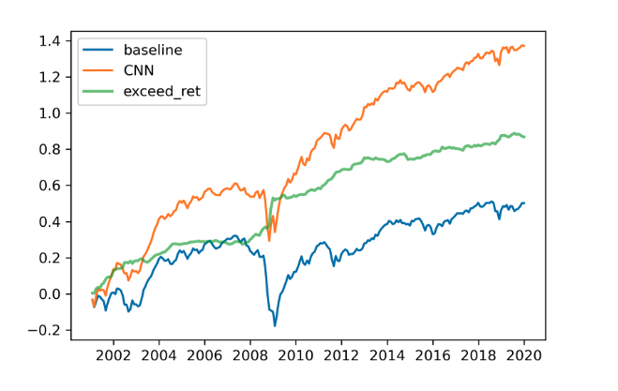
Implementation Overview
Guided implementation by github user lich99 → https://github.com/lich99/Stock_CNN
20-day stock charts provided by authors (5-day and 60-day data omitted)
Goal to train model and compare output probability logits to the cited paper
Focusing on I20/R5 and I20/I20 and comparing results with both equal weight and value weighted High-Low Portfolios
Github results

Slide 2
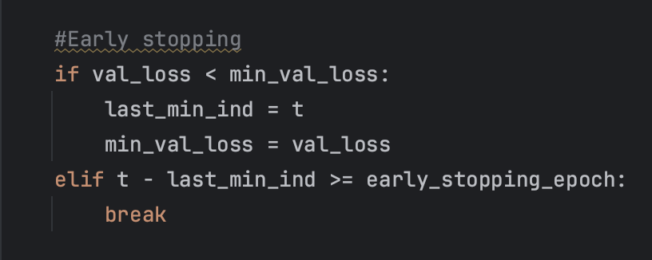
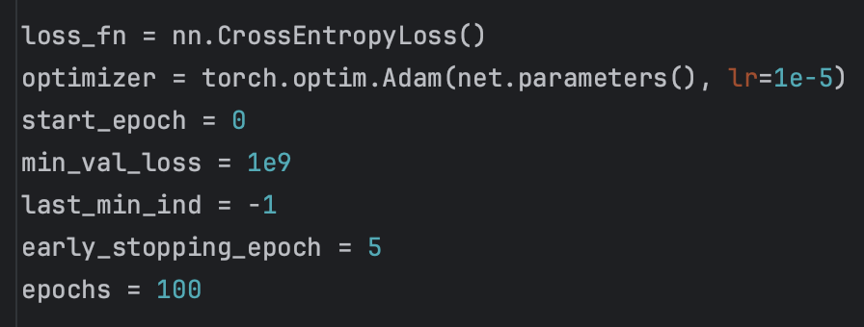
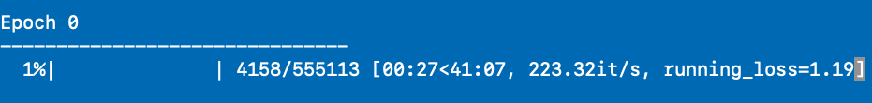
Train & Test
Sean’s implementation trained on all data
We are somewhat constrained by computational power → each Epoch w/ GPU took ~45 minutes
Years used for training == range(1991, 2001) == 273,000 images
Full training time == 3.2 hours before early stopping kicked in at 6th epoch
Final loss → testing= .685 val= .745
Early stopping
Parameters
Epoch 1

Slide 3
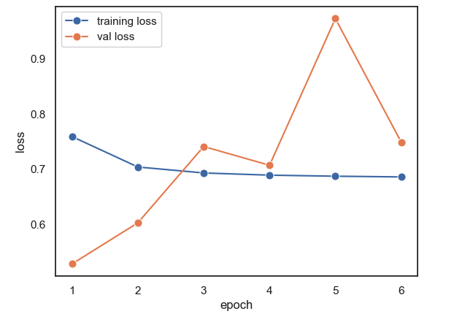

Train & Test (Cont…)
Error
Train/val error is confusing. Model stops after two consecutive higher val error. Something does not seem right…
Test
Implementation tested on all data (years 2001-2019)
Testing and logit predictions had runtime of 59 seconds with a final test error of .69
1.4MM images tested
Train & Val Error
Testing

Slide 4
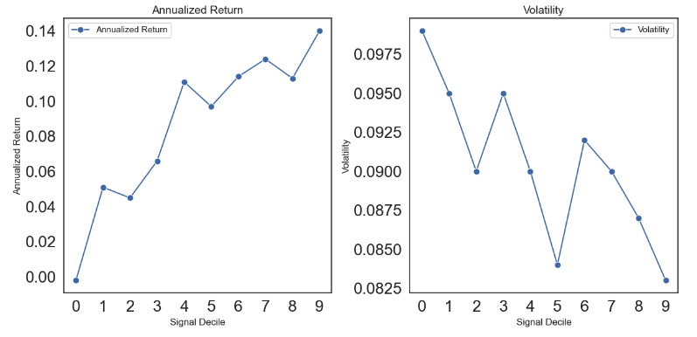
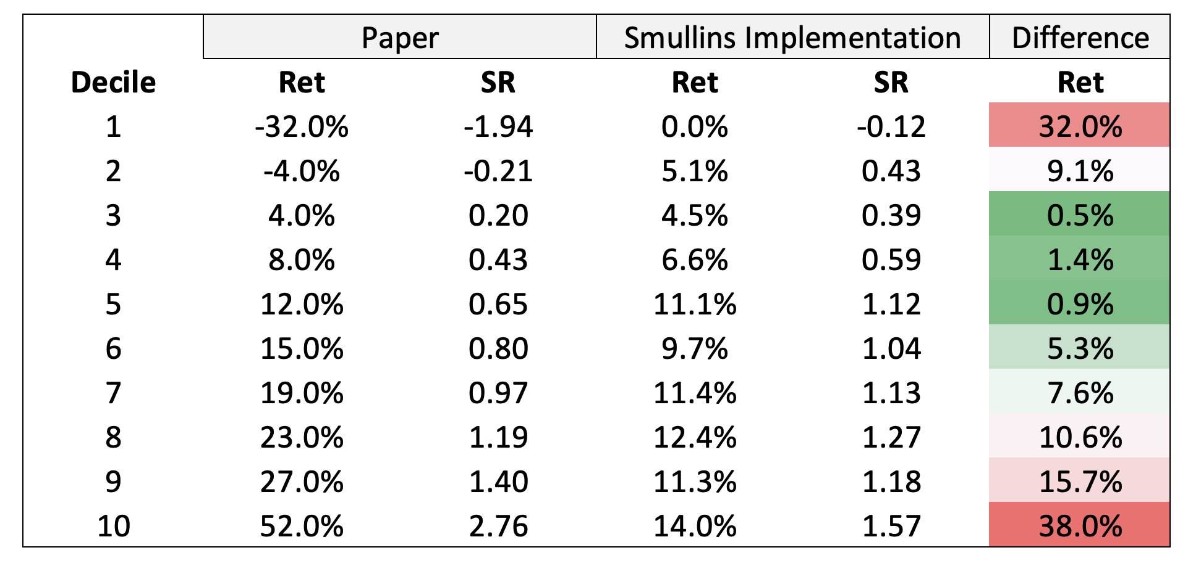
Evaluation & Comparison
Positive linear relationship between return and decile
14% return on top (9)
~0% return on bottom (0)
In-between deciles monotonically increasing
Volatility in line with paper → it is not massively influenced by decile
Smullins implementation missing potency in identification of returns
Model able to discern returns with lowest decile 0% RET and highest decile 14%, but paper comparison we are missing potency of tail ends (eg: -32% return for decile 1)
Smullins Equal Weighted Return & Vol
Paper vs. Smullins I20/R5

Slide 5
Thoughts
Very impressed with the model → able to discern deciles monotonically increasing and sort (14% versus 0%)
I am confused between value weight and equal weight, our results look almost exact to their value weighted, High-Low (10-1) portfolio
I feel something is wrong with the train/val process
Is training supposed to be that long w/ GPU utilization (40min per epoch)?
Val error does not make much sense as it jumps around, BUT the last epoch performs best on the test set
Shouldn’t we have more epochs for training? Parameter set to 100 but early stopping at 6…
Paper vs. Smullins difference could be the way I am splitting the logit outputs → We are using 10 equal-frequency bins in line with the paper? What if we used bins by weight or return? This may help potency

